Slide 1
Engineering Economics| MEE2001 | 3 Credits | 3 0 0 3
Economic Decision Making

Slide 2
Economic Decision Making
Economic decision making refers to the process of making choices or selecting alternatives from available options in a manner that maximizes utility, minimizes costs, and achieves certain objectives in an economy.
These decisions can be made by individuals, households, businesses, governments, or other economic agents and are based on rational thinking, considering both the benefits and costs associated with different courses of action.

Slide 3

Decision-Making Process includes:
Recognizing and defining the nature of a decision situation
Identifying alternatives
Choosing the ‘best’ [most effective] alternative and putting it into practice.

Slide 4

Decision-Making Process
Sometimes effective decisions must be made to:
Optimize some set of factors such as profits, sales, employee welfare and market share or
Minimize loss, expenses or employee turnover or
Select best method for going out of business, laying off employees, or terminating strategic alliance

Slide 5
Decision-Making Process
Managers make decisions about both Problems (undesirable situations) and opportunities (desirable situations).
Cutting costs by 10%
Learning that the company has earned higher than projected profits
It may take a long time before a manager can know for sure if the right decision was made.

Slide 6
Key Elements in Economic Decision Making
Scarcity: The fundamental concept that resources are limited, and there are unlimited wants and needs. Economic decisions involve allocating scarce resources to fulfil various needs and desires.
Opportunity Cost: The cost of forgoing the next best alternative when making a decision. When resources are used for one purpose, they are no longer available for other uses, resulting in an opportunity cost.
Marginal Analysis: Evaluating the additional benefits and costs of a small change in the level of an activity. Economic decision makers often consider the marginal benefits and the marginal costs to determine the optimal level of an activity.
Incentives: Factors that influence the behaviour of individuals or organizations, such as rewards or penalties. Rational economic agents consider incentives when making decisions.

Slide 7
Key Elements in Economic Decision Making
Trade-offs: The need to give up one thing to obtain another. Economic decisions often involve balancing competing objectives and making trade-offs to achieve the best outcome.
Rationality: The assumption that economic decision makers act in their own self-interest, aiming to maximize their utility or economic well-being. This doesn't necessarily imply pure selfishness but suggests a logical evaluation of options to attain personal or collective goals.
Decision-making models: Economists often use various models, such as cost-benefit analysis, utility maximization, and production possibilities frontier, to analyse and predict economic decisions.

Slide 8

Types of Decisions
Programmed decision is one that is fairly structured, or they are based on pre-defined guidelines and procedures and are quickly taken by referring to the rules laid down earlier.
Nonprogrammed decision is one that is unstructured and occurs much less often than a programmed decision.

Slide 9

Programmed Decisions. .
Many decisions regarding
basic operating systems and
procedures and
standard transactions category.
McDonald’s
organizational
fall into this
employees are
Mac
trained to make the Big
according
to specific procedures.
Starbucks,
and many other
organizations, use programmed
decisions to purchase new
cups
supplies [coffee beans, and napkins].

Slide 10

Nonprogrammed Decisions. ..
Most of the decisions made by top managers involving strategy and organization design are nonprogrammed.
Decisions about mergers, acquisitions and takeovers, new facilities, new products, labor contracts and legal issues are nonprogrammed decisions.
Managers faced with nonprogrammed decisions must treat each one as unique, investing great amounts of time, energy and resources into exploring the situation from all views.
Intuition and experience are major factors in these decisions.

Slide 11
Importance of Economic Decision Making in Engineering Projects
Cost Control: Engineering projects often have budget constraints. Efficient economic decision making helps control costs by identifying cost-effective solutions and optimizing resource allocation. This ensures that projects remain within the approved budget without compromising on quality or functionality.
Risk Management: Every engineering project involves inherent risks. Economic analysis helps assess the financial risks associated with different project options, allowing engineers to select alternatives that offer the best risk-reward balance. This minimizes the likelihood of unexpected financial setbacks during project execution.
Return on Investment (ROI): Engineering projects require significant investments, and stakeholders expect a return on their investment. Economic decision-making helps evaluate potential returns from different project options, enabling the selection of projects with the highest ROI and ensuring that resources are utilized efficiently.

Slide 12
Importance of Economic Decision Making in Engineering Projects
Life Cycle Cost Analysis: Engineering projects often have long lifecycles. Considering only the initial construction cost might lead to poor decisions if long-term costs (e.g., maintenance, operation, and decommissioning) are not factored in. Economic analysis allows engineers to assess the life cycle costs of various alternatives and make choices that minimize the total cost of ownership over the project's lifespan.
Sustainability and Environmental Impact: Economic decision making can also contribute to sustainable engineering practices. By incorporating environmental and social costs into the analysis, engineers can identify environmentally friendly solutions that might not only benefit the project but also the broader community and the planet.
Stakeholder Alignment: Engineering projects involve multiple stakeholders with different interests and priorities. Economic analysis provides a quantitative basis for decision making, facilitating communication and alignment among stakeholders by focusing on objective data and metrics.

Slide 13
Importance of Economic Decision Making in Engineering Projects
Project Feasibility: Economic decision-making helps determine the feasibility of a project before it proceeds to implementation. Analysing costs and benefits early on can reveal whether a project is economically viable and helps avoid investing resources in unviable ventures.
Resource Optimization: Engineers must optimize the use of resources, including materials, labor, time, and energy. Economic analysis allows for effective resource allocation, reducing waste and increasing efficiency throughout the project.
Competitiveness: In the context of business and industry, economic decision making can provide a competitive edge. Projects that are economically viable and offer higher returns have a better chance of attracting investors and clients, enhancing a company's position in the market.

Slide 14
Case Study
Introduction:
In this case study, A company expanding its operations and exploring an economic decision-making. The company specializes in producing electronic goods, primarily smartphones and tablets. The management team has identified a growing market demand for their products and believes that expanding their manufacturing operations could lead to increased profits and market share. However, they also face several challenges and uncertainties that need to be carefully considered before making a final decision.
Background:
Company has been operating successfully for the past 40 years, primarily in the domestic market. Their products have gained popularity due to their innovative features and competitive pricing. As a result, the company has experienced steady growth and has a strong reputation for product quality and customer service.

Slide 15
Problem Statement:
The management team at ABC Manufacturing is presented with the opportunity to expand their operations by establishing a new manufacturing facility. The main challenge they face is whether to expand domestically or internationally.
They have two potential locations in mind:
Domestic Expansion: The company can set up a new manufacturing plant in a different state within the country. This option offers the advantage of familiarity with local regulations, workforce, and supply chain partners.
International Expansion: Alternatively, ABC Manufacturing can explore the possibility of setting up a manufacturing facility in a foreign country, such as a Southeast Asian nation. This option offers potential cost savings on labor and access to a growing consumer market.

Slide 16
Key Factors to Consider
Labor Costs: Compare the labour costs between the domestic and international locations. Determine whether the potential savings from lower labour costs in the foreign country outweigh the additional shipping and logistics expenses.
Market Potential: Analyse the demand for smartphones and tablets in both the domestic and international markets. Identify potential growth opportunities and challenges in each market.
Regulatory Environment: Assess the ease of doing business in the foreign country, including tax regulations, trade policies, and legal requirements. Compare this with the existing regulations in the domestic market.
Supply Chain Management: Evaluate the logistical aspects of setting up an international manufacturing facility, including transportation costs, lead times, and potential risks of disruptions.
Political and Economic Stability: Consider the political and economic stability of the foreign country as it can significantly impact the long-term viability of the expansion.
Brand Reputation and Customer Perception: Examine how an international expansion might impact the company's brand image and customer perception.
Financial Viability: Perform a comprehensive financial analysis, including projected revenue, expenses, and return on investment for both domestic and international expansion scenarios.

Slide 17
Conclusion:
The decision-making process for company involves carefully evaluating all relevant factors to make an informed and economically viable choice. Each option presents unique opportunities and challenges that must be weighed against the company's growth objectives, financial capabilities, and risk tolerance. By conducting a thorough analysis, the management team can arrive at a well-grounded decision that aligns with the long-term strategic goals of the company.

Slide 18
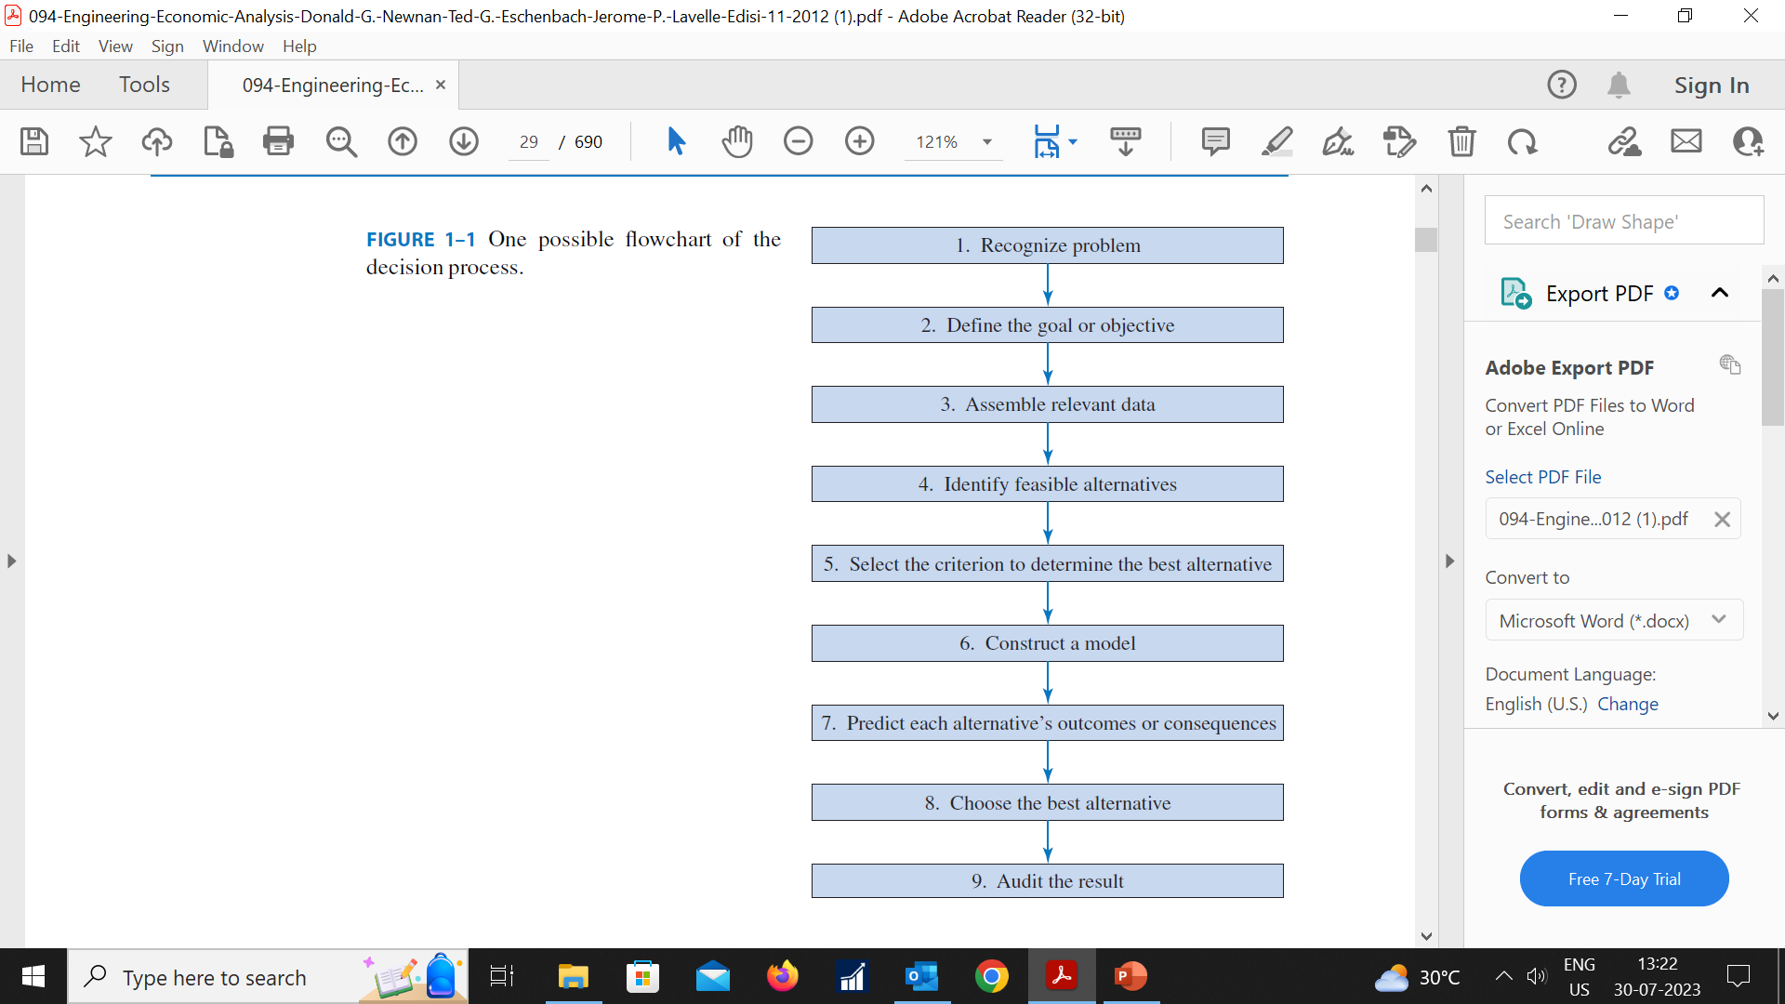
Rational Decision-Making Process
Recognize the problem.
2. Define the goal or objective:What is the task?
3. Assemble relevant data: What are the facts? Is more data needed,
and is it worth more than the cost to obtain it?
4. Identify feasible alternatives.
5. Select the criterion for choosing the best alternative: possible criteria
include political, economic, environmental, and social. The single criterion may be a composite of several different criteria.
6. Mathematically model the various interrelationships.
7. Predict the outcomes for each alternative.
Choose the best alternative.
9. Audit the results.

Slide 19
Buying a car: Audi vs BMW
Recognize a decision problem
Define the goals or objectives
Collect all the relevant information
Identify a set of feasible decision alternatives
Select the decision criterion to use
Select the best alternative
Need a car
Want High Level Security System
Gather technical as well as financial data
Choose between Audi vs BMW
Want minimum total cash outlay
Select Audi

Slide 20
Engineering Economic Decisions
Manufacturing
Profit
Planning
Investment
Marketing

Slide 21
Factors Influencing Economic Decisions in Engineering
Cost-Benefit Analysis: Engineers often perform cost-benefit analyses to compare the costs of different engineering solutions against the potential benefits they offer. This analysis helps in selecting the most economically viable option that maximizes the return on investment.
Budget Constraints: Engineering projects must operate within a defined budget. Engineers need to make decisions that align with the available financial resources while achieving project objectives efficiently.
Technological Feasibility: The feasibility of implementing a particular engineering solution heavily depends on the state of technology and the availability of necessary resources. Advanced technologies may offer efficiency improvements, but they can also come with higher initial costs.
Resource Availability: Availability and cost of resources such as raw materials, labor, and energy play a significant role in economic decision-making. Engineers need to consider resource availability to optimize the project's overall cost.
Life Cycle Costs: Engineering decisions should not only consider the upfront costs but also the life cycle costs of a project. This includes maintenance, operating expenses, and potential decommissioning or disposal costs.
Market Demand and Competition: In the case of engineering products, market demand and competition can significantly influence economic decisions. Engineers must consider the potential market size, consumer preferences, and the competitive landscape while developing new products.

Slide 22
Factors Influencing Economic Decisions in Engineering
Regulatory and Environmental Considerations: Compliance with regulations and environmental standards can impact the design and implementation of engineering projects. Failing to meet these requirements can lead to additional costs and potential legal issues.
Risk Assessment: Engineers need to evaluate and mitigate risks associated with different choices. Risk analysis involves identifying potential problems, estimating their likelihood, and understanding the consequences of each risk scenario.
Time Constraints: Time-to-market and project deadlines can be critical in the engineering industry. Economic decisions often need to be made within specific timeframes to meet project schedules.
Government Policies and Incentives: Government policies, subsidies, tax incentives, and grants can influence engineering decisions. For instance, policies promoting renewable energy may drive investment in certain engineering projects.
Stakeholder Expectations: The expectations and preferences of stakeholders, including clients, investors, and the public, can shape economic decisions. Meeting stakeholder requirements is crucial for the success and acceptance of engineering projects.
Scalability and Flexibility: Engineering decisions that allow for scalability and flexibility can be economically advantageous. Designs that can adapt to changing requirements or expansion can save costs in the long run.
In summary, economic decisions in engineering are multifaceted, involving considerations of technical feasibility, financial constraints, market dynamics, regulations, and risk assessment. Successful engineering projects require a balance of these factors to achieve optimal outcomes for all stakeholders involved.

